Slide 1


Slide 2
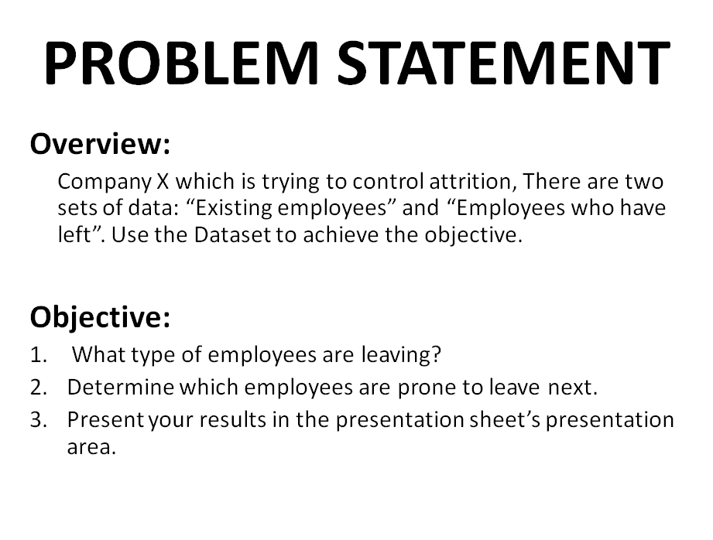

Slide 3
DEPENDENCIES/EXTERNAL RESOURCES
The success of this project was greatly dependent on this following Python modules and packages, of which its output is the general result of the project.
pandas
numpy
sklearn.model_selection
train_test_split
sklearn.ensemble
RandomForestClassifier
sklearn.preprocessing
LabelEncoder
sklearn.metrics
accuracy_score

Slide 4
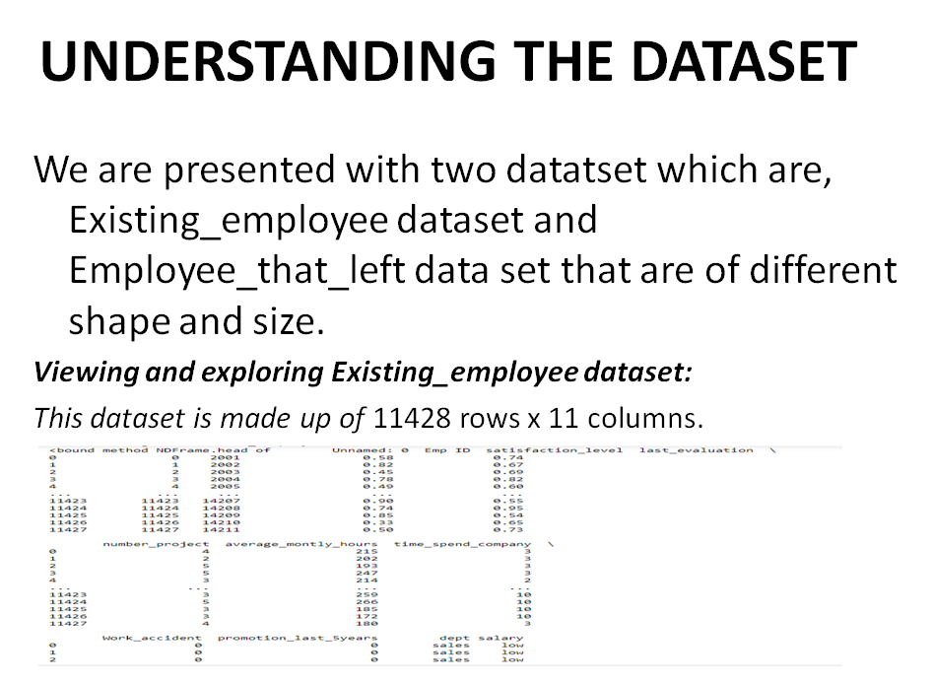

Slide 5
def existing_employee():
existing_employees = pd.read_csv("Existing employees.csv")
existing_employees_count = len(existing_employees["Emp ID"])
left_company = []
while existing_employees_count != 0:
left_company.append("YES")
existing_employees_count -= 1
print("Before adding the new left_company column")
print(existing_employees.head)
existing_employees["left_company"] = left_company
print("After adding the new left_company column")
return existing_employees
INPUT FOR BOTH DATASET RESPECTIVELY
def left_employee():
left_employees = pd.read_csv("Employees that left.csv")
left_employees_count = len(left_employees["Emp ID"])
left_company = []
while left_employees_count != 0:
left_company.append("NO")
left_employees_count -= 1
left_employees["left_company"] = left_company
print(left_employees.head)
return left_employees
employees_that_left = left_employee()
employees_that_left.head()

Slide 6
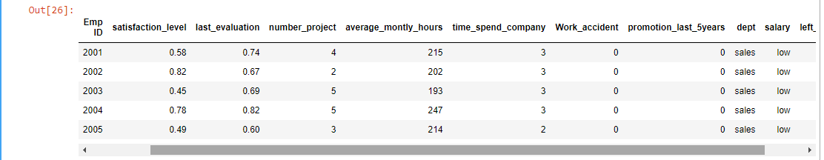
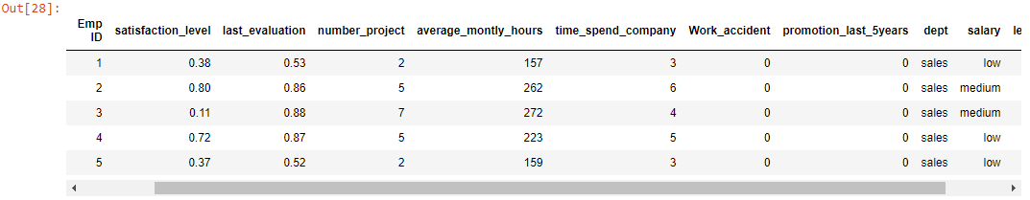
OUTPUT:
Viewing and exploring Employee_that_left dataset:
This dataset is made up of 3571 rows and 12 columns

Slide 7
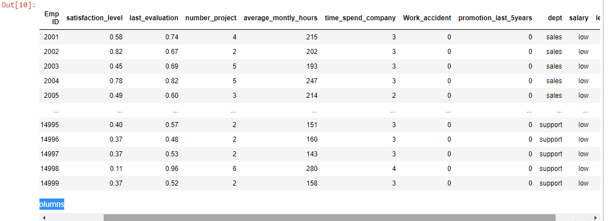
MERGING THE TWO DATASET
This is to achieve a linear dataset we could use to develop a model and make predictions.
INPUT:
frames = [existing_employees, employees_that_left]
total_employees = pd.concat(frames)
total_employees.to_csv("total_employee_dataset.csv")
total_employees
OUTPUT:
This is made up of 14999 rows and 12 columns which now holds the full employee dataset for both existing and non-existing employees

Slide 8
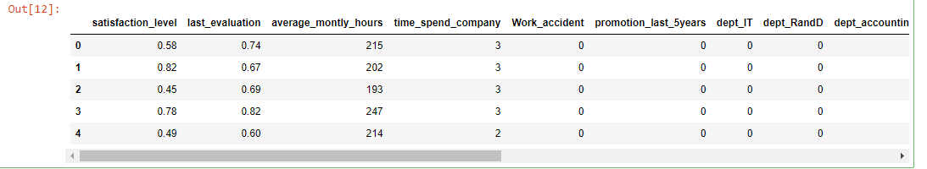
SELECTING FEATURE AND TARGET VARIABLES
INPUT:
#Selecting the feature and target dataset
X=total_employees[["satisfaction_level","last_evaluation","average_montly_hours","time_spend_company","Work_accident","promotion_last_5years","dept","salary"]]
Y = total_employees["left_company"]
Then encoding categorical datas in our feature dataset with dummy data to maintain column names
# Encoding categorical data AND Encoding independent variable
X = pd.get_dummies(X)
X.head() OUTPUT

Slide 9
We also need to encode our target because it is a categorical data (the left_company). This is to replace YES and NO with numerical values.
INPUT:
# Encoding dependent variable
le = LabelEncoder()
Y = le.fit_transform(Y)
OUTPUT:
Then we split out dataset to train and test for model accuracy calculation, create our model and fit the train data to it.
INPUT:
# Split dataset into train and test set
X_train, X_test, Y_train, Y_test = train_test_split(X,Y,test_size=0.40,random_state=0)
#Create the Random Forest model and fitting the data
classifier = RandomForestClassifier(n_estimators=11, criterion='entropy', random_state=0)
classifier.fit(X_train, Y_train)

Slide 10
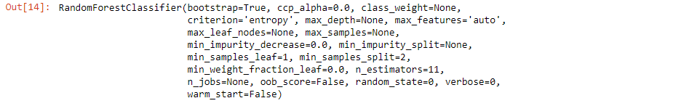
The out is a trained model ready to predict out target.
OUTPUT:
The next step is to actually predict our target (dependent variable).
INPUT:
# Predicting Test set results
Y_pred = classifier.predict(X_test)
print(Y_pred)
OUTPUT:

Slide 11
MODEL EVALUATION
INPUT:
#Calculating and printing the model accuracy
print(f'The accurancy score is:{accuracy_score(Y_pred,Y_test)*100}%')
OUTPUT:

Slide 12
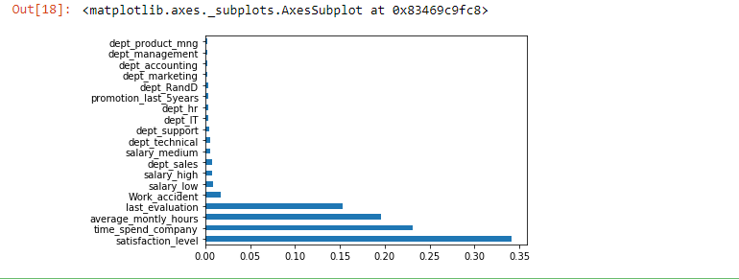
ATTRITION
We have developed our model which is able to tell employee that is prone of leaving the company but we don't know the attribute that are contributing to high attrition in the company, let's solve that.
INPUT:
feat_importances = pd.Series(classifier.feature_importances_, index=X.columns)
feat_importances = feat_importances.nlargest(20)
feat_importances.plot(kind='barh')
From our output, we can see that satisfaction_level, time_spend_company,average_monthly_hours and last_evaluation are the top four contributors to employee attrition

Slide 13
PREDICTING EMPLOYEE THAT ARE PRONE TO LEAVE NEXT
Now we need to know the employees that will be leaving the company next.
INPUT:
#Reselecting the feature and target dataset in order to predict employee that is prone to leave
X1 = total_employees[["satisfaction_level","last_evaluation","average_montly_hours","time_spend_company","Work_accident","promotion_last_5years","dept","salary"]]
Y1 = total_employees["left_company"]
# Split dataset into train and test set
X_train1, X_test1, Y_train1, Y_test1 = train_test_split(X1,Y1,test_size=0.40,random_state=0)
employee_prone_to_leave = pd.DataFrame(X_test1)
employee_prone_to_leave["left_company"] = Y_test1
employee_prone_to_leave["predicted"] = Y_pred
# Predicting employees that will leave the company
leaving = employee_prone_to_leave[(employee_prone_to_leave["predicted"] == 1) & (employee_prone_to_leave["left_company"] != "YES") ]
leaving

Slide 14
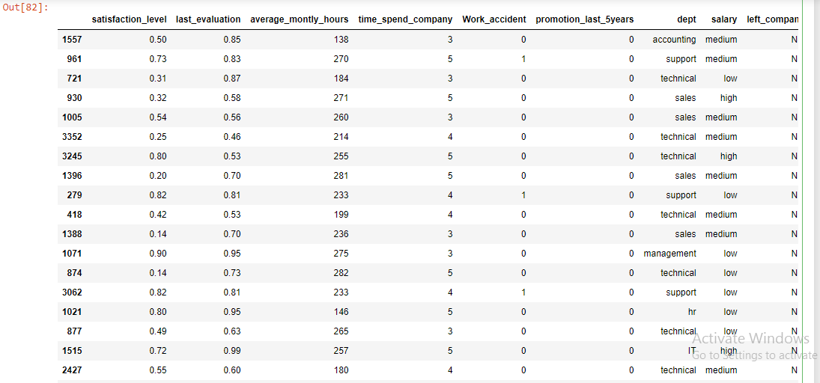
OUTPUT:

Slide 15
SATISFACTORY SOLUTION
1.Let there be a measure for performance and reward accordingly
2.Create an independent measure of which promotion variable will depend on, this helps to regulate promotion processes within the company.
3.Once someone is promoted, let there be an increase in his/her income level.
4.Allocate award and titles by achievement and commitment.
5.Sanitize the Sale, Support and Technical department to reduce death incidents and reduce their allocated work.
6.Allocate more work to the high income earners to get them engaged in order to increase their satisfaction. Having no work to do is making them lose interest in their job.
7.Create an annual evaluation pipeline for all employees of all level

